Slide 1


Problem Statement :- Automatic Assessment of Pavement condition based on road photographs
Problem Code:- MK199
Domain bucket :- Software - Web App development
Organization:- Ministry of Rural Development

Slide 2
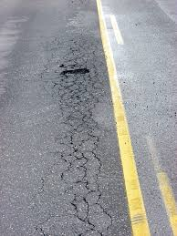
Road2
Road2_Img3
Location A
Location B
Road2_Img1
Road2_Img2
Road1
Road1_Img1
Road1_Img2
Road1_Img3
Road1_Img4
Road_Img5
Road1_Img6
Road1_Img7
Road1_Img8
Road1_img1_crop1_Pothole.jpg
Road1_img1_crop2_SplippageCrack.jpg
Road1_Img1.jpg

Slide 3
Proposed Solution
We are using Object Detection and Classification Model/ Image Processing Techniques
Using two different State of the Art Models (most accurate Faster RCNN or fastest YOLO) for Object Detection.
The detection result will be our final output with either fast approach or with best accuracy depending on the use.
The result will be sent for further classification and identification of level and type of road damage.
Detailed Report will be generated and can be viewed both online Web Portal and offline Excel sheet with automated sharing (or Mailing) option.
Upon Classification it will also suggest approximate cost so more accurate tender can be issued.
Further a Lite model will be made available so that it can be integrated into Android/ IOS app like “Meri Sadak” , “Sukhad Yatra” so that it can directly send report to respective authority thus helping in fast decision making.
GPS Tagging will tell the exact location of the pothole or cracks so that finding them will be easy for workers.

Slide 4


Work Flow
Road issue Detection
Model
Working
Category Classification
Model
Working
Category of issue found in Cropped image
Sets of Road Images with Road ID or video of the particular Road
Pool of Images of each Road with unique Image ID
One image from the pool
Cropped Images where road issue are found
Category
Category
One image from the pool of images
Category
Road1
Road2
Cropped parts from the image with unique Cropped ID
Categories of defects found in cropped parts
Sets of images for different roads

Slide 5
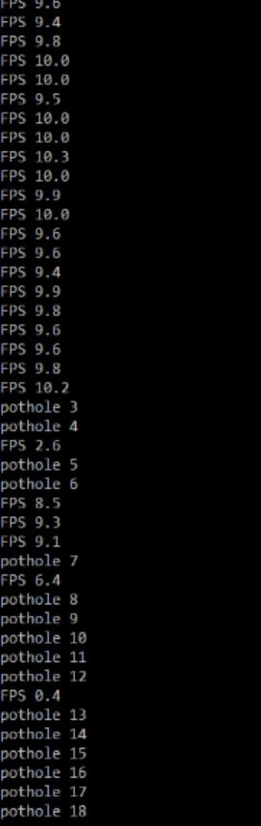
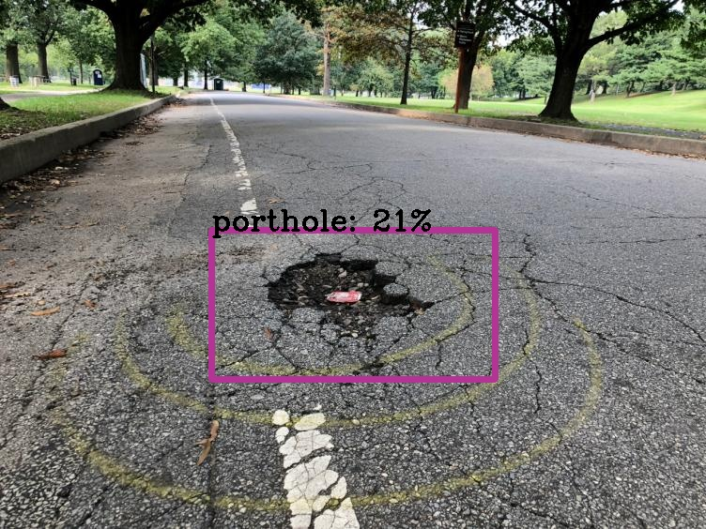

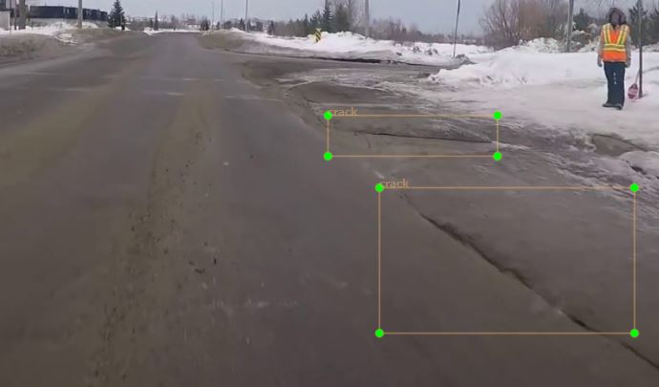

Results till Now
Classification after detection
More severe
Less severe
Pothole and cracks detected
We get cropped image of detected potholes/cracks and they further passed through classification algorithm to find out how severe the defect is
Algorithm counts how much pothole detected
https://drive.google.com/open?id=1Rdv2AWx1psxor8Zd1h1My2sYE4OLpYH7
Link for our working video here

Slide 6
Use Case
The task of finding the PCI Index can be automated.
Repairing of roads can be made faster as this will speed up the whole process.
It can be integrated into Android/ IOS app like “Meri Sadak” , “Sukhad Yatra” so that it can directly send report to respective authority thus helping in fast decision making.
Dependencies
Large Dataset
A good GPU(Nvidia 1050TI 4GB or better)

